Slide 1


Server Log Data Extraction and User History Database Update
This presentation outlines the process of extracting email addresses and dates from a server log file (mbox.txt), storing the data in MongoDB and SQLite databases, and performing analytical queries to gain insights. The project aims to ensure clean, accurate data for historical tracking and analysis. This program assessment submission details the approach, tools, and findings of the project.
by Yash Dalvi

Slide 2
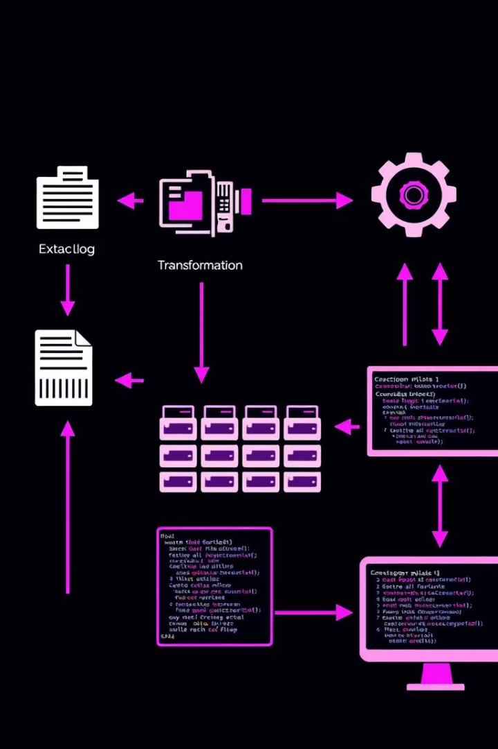



Problem Statement and Objectives
Objective
Goal
Extract email addresses and dates from a server log (mbox.txt) and store them in databases.
Ensure clean, accurate data for historical tracking and analysis.
Tasks
Extract and transform data, store in MongoDB and SQLite, and run analytical queries.
The primary objective is to extract relevant information from a server log file, specifically email addresses and dates. The ultimate goal is to maintain a clean and accurate dataset that can be used for historical tracking and in-depth analysis. This involves several key tasks, including data extraction, transformation, storage in both MongoDB and SQLite, and the execution of analytical queries to uncover valuable insights.

Slide 3





Tools Used in the Project
Python
SQLite
MongoDB
Regex
Core language for scripting and automation.
Relational database for structured queries.
NoSQL database for flexible storage.
For parsing emails and dates.
This project leverages a variety of tools to achieve its objectives. Python serves as the core language for scripting and automation, enabling efficient data processing. SQLite is used as a relational database for structured queries, providing a reliable means of data analysis. MongoDB, a NoSQL database, offers flexible storage options. Regular expressions (Regex) are employed for parsing email addresses and dates from the log file.

Slide 4
Data Pipeline Approach
Extraction
Transformation
Storage
Error Handling
Used regex to parse mbox.txt for emails and dates.
Standardized dates to YYYY-MM-DD HH:MM:SS, normalized emails to lowercase.
MongoDB: Inserted into user_db.user_history collection. SQLite: Created user_history table with UNIQUE(email, date) constraint.
Try-except for file I/O, database connections, and date parsing.
The data pipeline consists of several key stages. In the extraction phase, regular expressions are used to parse the mbox.txt file for email addresses and dates. The transformation stage involves standardizing dates to a consistent format (YYYY-MM-DD HH:MM:SS) and normalizing email addresses to lowercase. The transformed data is then stored in both MongoDB and SQLite. Robust error handling is implemented throughout the pipeline to manage file I/O, database connections, and date parsing.

Slide 5
Data Analysis Approach
SQL Queries
1
Executed 14 SQL queries on SQLite database.
Helper Functions
2
run_query for execution, print_results for output.
Error Handling
3
Ensured robust error handling for database operations.
The data analysis approach involves executing a series of SQL queries on the SQLite database. A total of 14 queries were performed to extract various insights from the data. Helper functions, such as run_query for executing queries and print_results for displaying output, were utilized to streamline the process. Robust error handling mechanisms were implemented to ensure the stability and reliability of database operations.

Slide 6
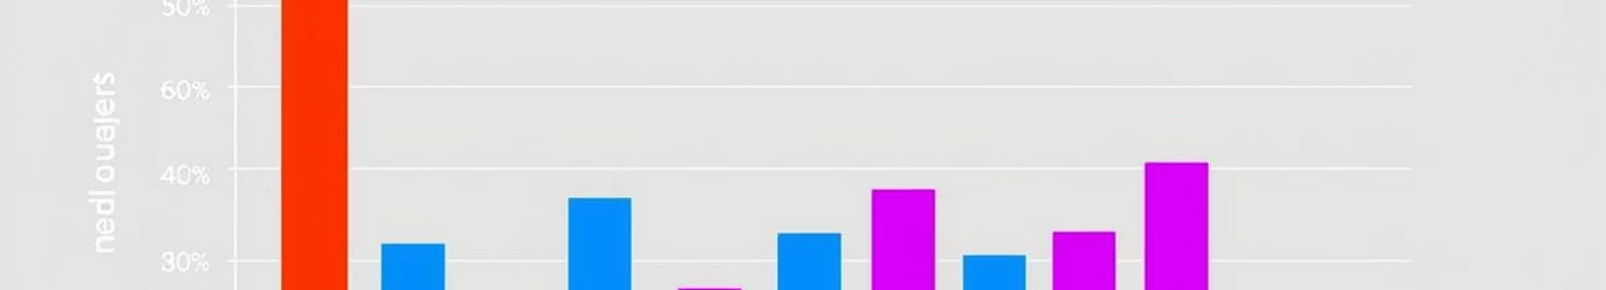
Key Insights Found
Domain Distribution
Temporal Trends
User Behavior
Gmail is the most common domain, followed by Yahoo.
Peak email activity at midnight–2 AM.
Some emails appear multiple times, with gaps up to 2 days between first and last activity.
The data analysis revealed several key insights. Gmail is the most prevalent email domain in the dataset, followed by Yahoo. Temporal trends indicate that email activity peaks between midnight and 2 AM. User behavior analysis shows that some email addresses appear multiple times in the log file, with gaps of up to two days between their first and last recorded activity. The dataset is clean, with no duplicate entries due to the UNIQUE constraint in SQLite.

Slide 7




Challenges and Solutions
Varied Date Formats
Used python-dateutil for flexible parsing.
Potential Duplicate Entries
Added UNIQUE(email, date) in SQLite.
Large Log Files
Processed file line-by-line.
Several challenges were encountered during the project. The log file contained varied date formats, which were addressed by using the python-dateutil library for flexible parsing. To prevent potential duplicate entries, a UNIQUE(email, date) constraint was added to the SQLite database. The possibility of large log files straining memory was mitigated by processing the file line by line, rather than loading the entire file into memory at once.

Slide 8




Conclusion and Key Takeaways
Successful Pipeline
Demonstrated Proficiency
Successfully built a pipeline to process and analyze server log data.
Demonstrated proficiency in Python, SQL, MongoDB, and regex.
Actionable Insights
Uncovered actionable insights about email patterns.
In conclusion, this project successfully built a data pipeline to process and analyze server log data. The project demonstrated proficiency in Python, SQL, MongoDB, and regular expressions. Actionable insights about email patterns were uncovered through data analysis. The code is reusable and well-documented for future extensions, providing a solid foundation for further development and analysis.

